Slide 1
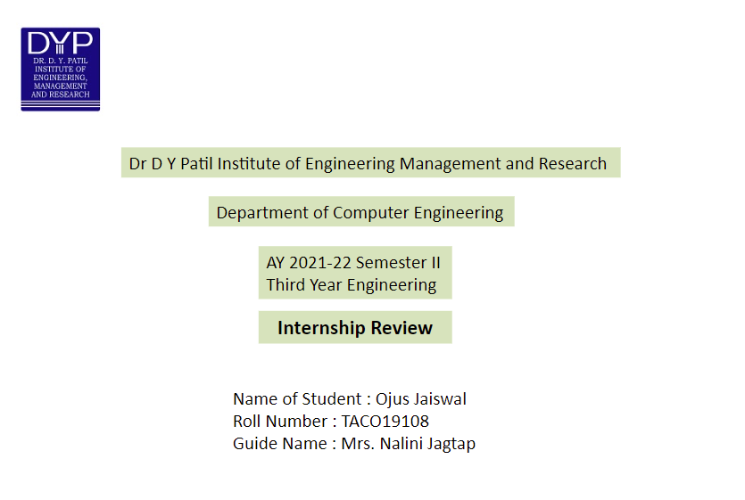

Slide 2
SUMMARY OF TOPICS
MAIN POINTS COVERED
Company Profile
Designation and Duration of Internship
Problem Statement
Objectives
Motivation
Scope
Methodological Details
Result
Conclusion

Slide 3
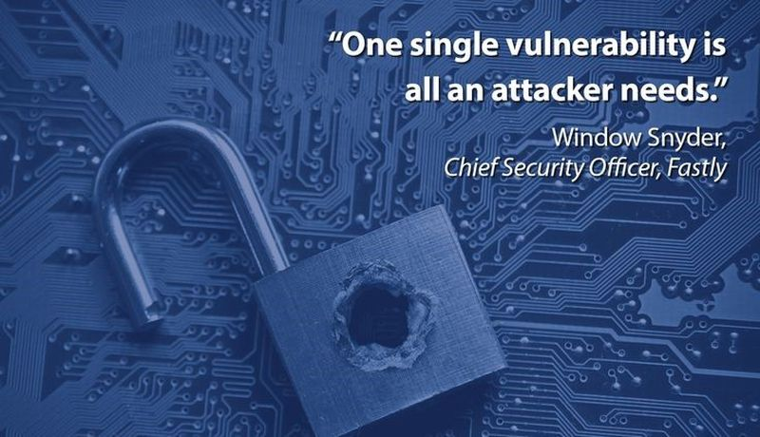

Slide 4

COMPANY PROFILE
TALAKUNCHI NETWORKS PVT. LTD.
ADDRESS: 9TH FLOOR, 901, QUANTUM TOWER KALPATARU PLAZAM, CHINCHOLI BUNDER RD, NADIYAWALA COLONY 2, MALAD WEST, MUMBAI, MAHARASHTRA 400064
.

Slide 5
DESIGNATION AND DURATION OF INTERNSHIP
Cyber Security and Ethical Hacking Intern
Duration :- 2 Months
Dates :- 10 January, 2022 to 10 March, 2022

Slide 6
PROBLEM STATEMENT
LEARN CYBER SECURITY FUNDAMENTALS AND APPLY GAINED KNOWLEDGE TO COMPLETE FOLLOWING TASKS :-
1) INFORMATION GATHERING AND EXPLOITATION (AUTHENTICATION BYPASS)
2) SCANNING USING OWASP ZAP
3) SCANNING FOR OPEN PORTS AND ATTACKING THEM
4) SYSTEM HACKING
5) EXPLOITING SERVER VULNERABILITIES

Slide 7


Objective
The main objective is to learn about various cyber security concepts and ethical hacking tools.

Slide 8
MOTIVATION
To work on finding vulnerabilities of System and Websites.

Slide 9
SCOPE
According to the Data Security Council of India (DSCI), which is one of the top associations for cybersecurity, the cyber security business employed around 2 lakh workers in 2020, up from 1.10 lakh in 2019, and there are approximately 50,000 employment openings in the cyber security sector in India today. DSCI has predicted that the cybersecurity market will employ around 10 lakh employees by 2025.
The demand for cyber security is expected to rise as digital transactions, and payments, become more prevalent, according to the DSCI. As a result, the demand for digital experts to handle the load will increase dramatically

Slide 10
Methodological Details
Information Gathering and Exploitation (Authentication Bypass)
Authentication bypass vulnerability could allow attackers to perform various malicious operations by bypassing the device authentication mechanism.
What's the issue - Authentication bypass exploit is mainly due to a weak authentication mechanism.
Organizations failing to enforce strong access policy and authentication controls could allow an attacker to bypass authentication.

Slide 11
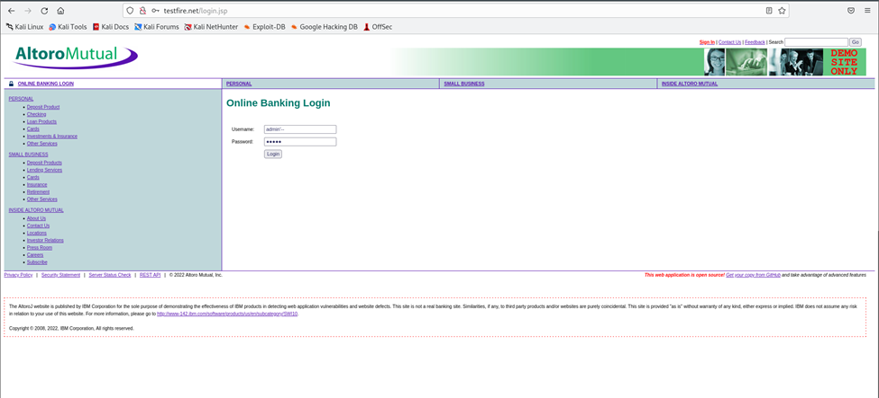
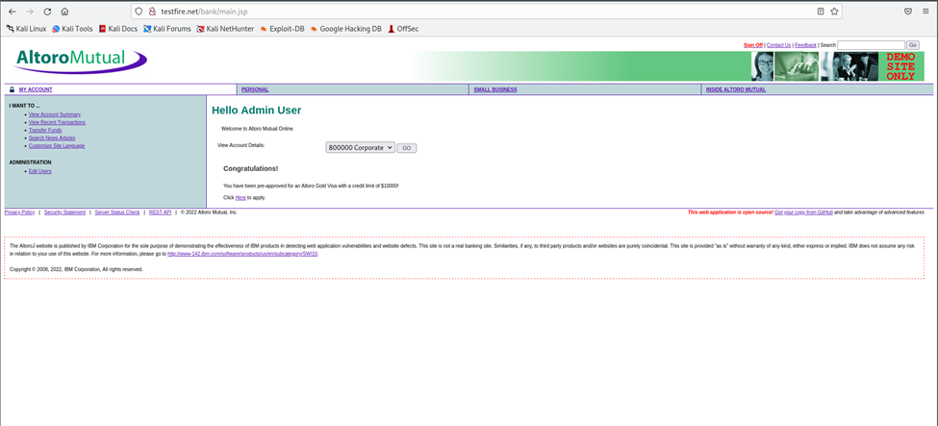

Slide 12
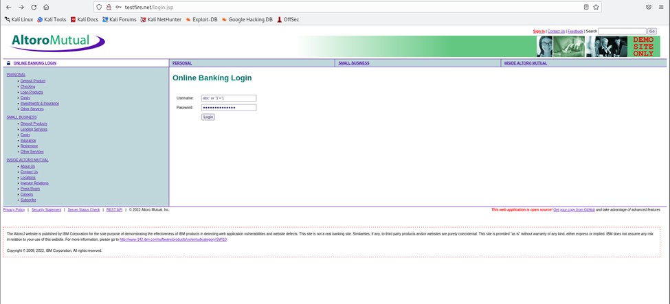
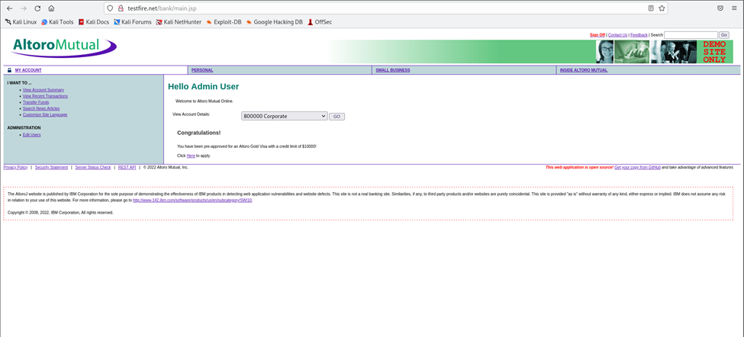

Slide 13
Scanning using OWASP ZAP
OWASP ZAP (short for Zed Attack Proxy) is an open-source web application security scanner. It is intended to be used by both those new to application security as well as professional penetration testers.
It is one of the most active Open Web Application Security Project (OWASP) projects[2] and has been given Flagship status.[3]
When used as a proxy server it allows the user to manipulate all of the traffic that passes through it, including traffic using https.
It can also run in a daemon mode which is then controlled via a REST API.

Slide 14
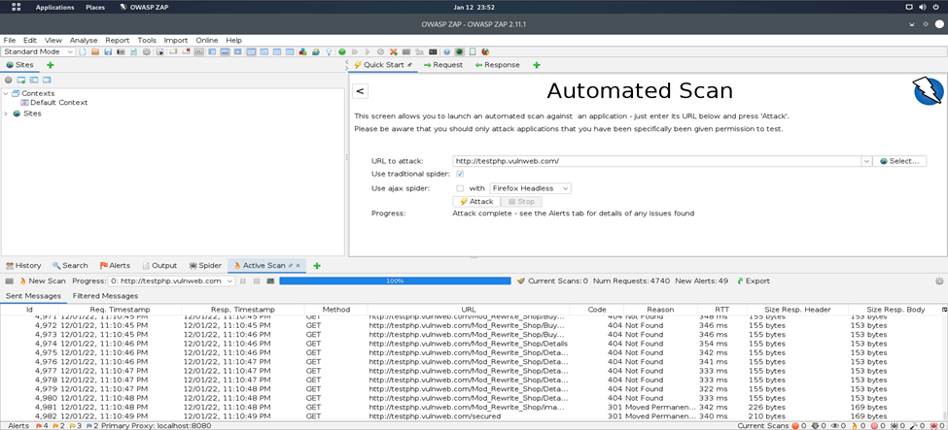
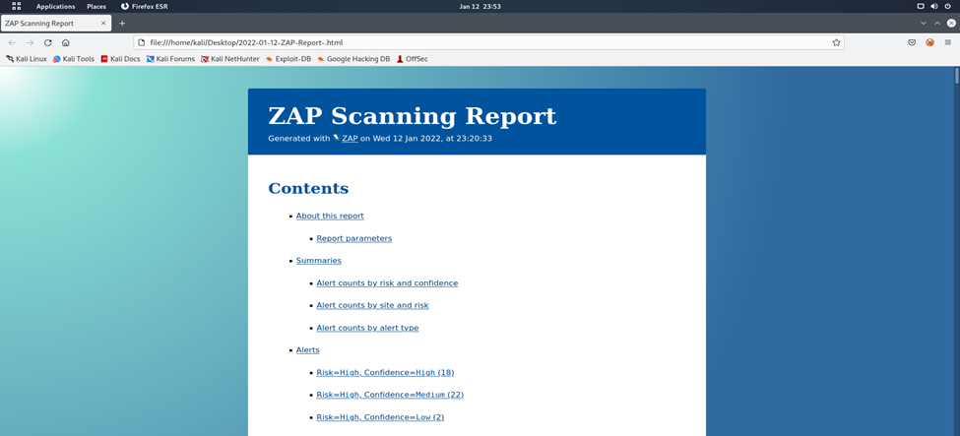

Slide 15
Scanning for Open ports and attacking them
Nmap is a robust tool for scanning computer networks, helping you to spot any weakpoints in a system. Its compelling feature set makes it the de-facto tool for monitoring open ports on your network. Some of its other features include host discovery, service detection, and OS fingerprinting.

Slide 16
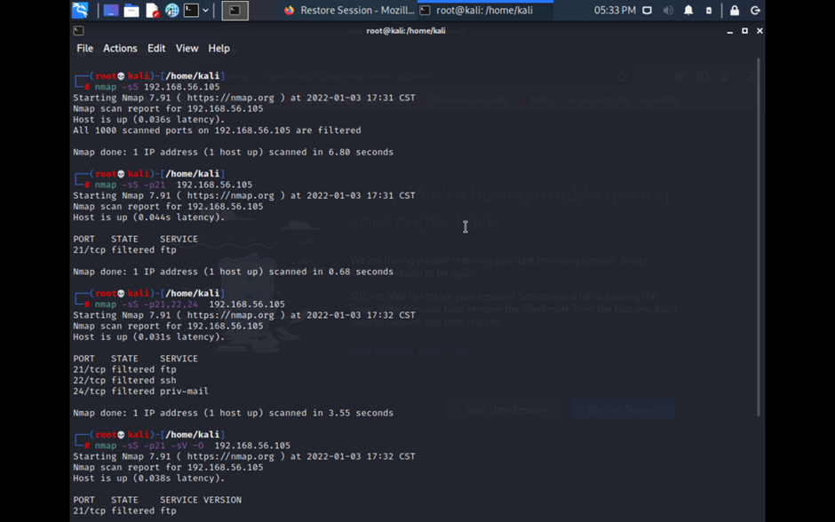

Slide 17
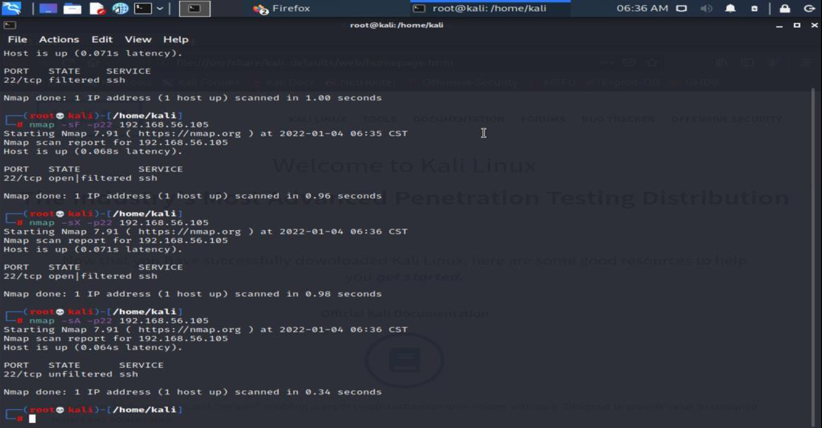

Slide 18
System Hacking
Hydra is a pre-installed tool in Kali Linux used to brute-force username and password to different services such as ftp, ssh, telnet, MS-SQL, etc. Brute-force can be used to try different usernames and passwords against a target to identify correct credentials.
In Metasploit any module that is not an exploit is an auxiliary module. Exploit modules always have a payload. Auxiliary modules are a fascinating feature of the framework allowing it to extend for a variety of purposes other than exploitation. You can create your own quick vulnerability scanners, port scanners, make MSF work as an FTP, HTTP or SMTP client and do a whole lot of other cool stuff. You have a ready to use code library at your disposal enabling quick development of such tools.

Slide 19
Nmap is a popular, powerful and cross-platform command-line network security scanner and exploration tool. It can also help you get an overview of systems that connected your network; you can use it to find out all IP addresses of live hosts, scan open ports and services running on those hosts, and so much more.
One of the interesting features of Nmap is the Nmap Script Engine (NSE), which brings even more flexibility and efficiency to it. It enables you to write your own scripts in Lua programming language, and possibly share these scripts with other Nmap users out there.
John the Ripper is a tool designed to help systems administrators to find weak (easy to guess or crack through brute force) passwords, and even automatically mail users warning them about it, if it is desired.
Crunch is a wordlist generator where you can specify a standard character set or any set of characters to be used in generating the wordlists. The wordlists are created through combination and permutation of a set of characters. You can determine the amount of characters and list size.
This program supports numbers and symbols, upper and lower case characters separately and Unicode.

Slide 20
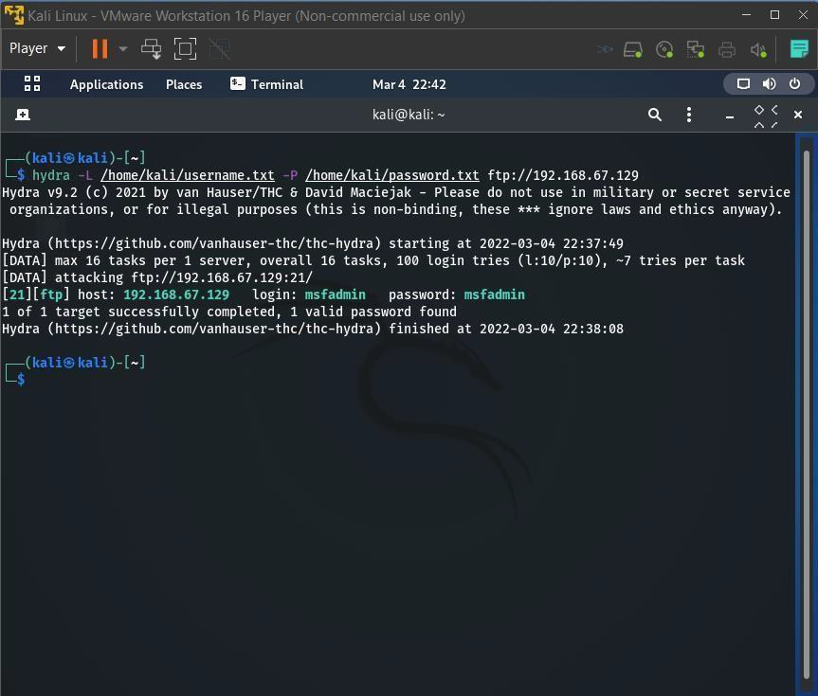

Slide 21
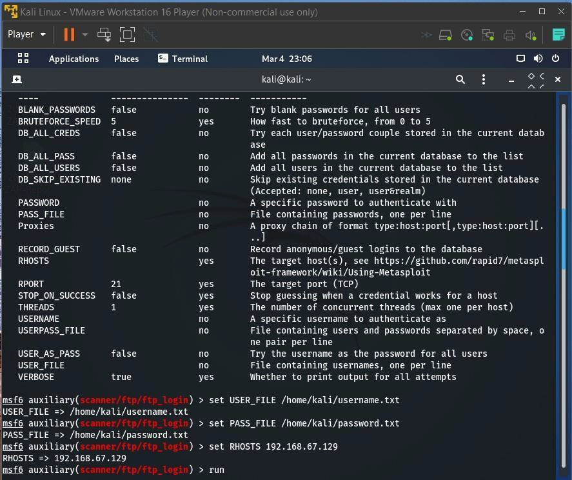
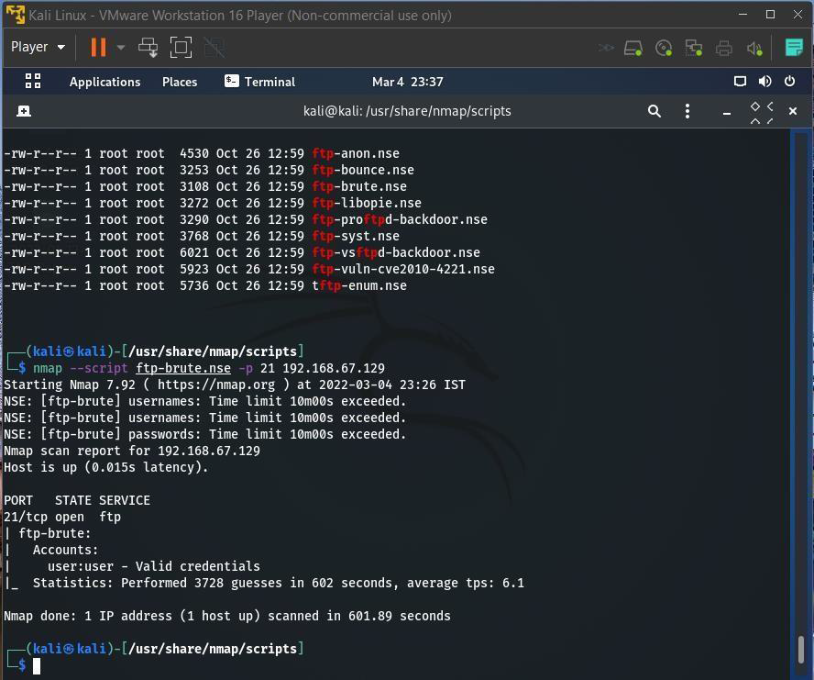

Slide 22
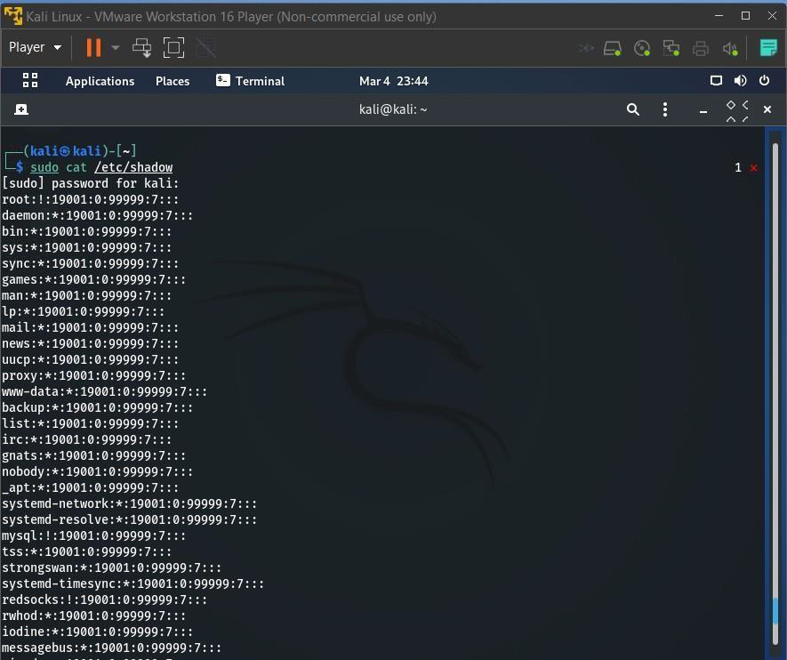
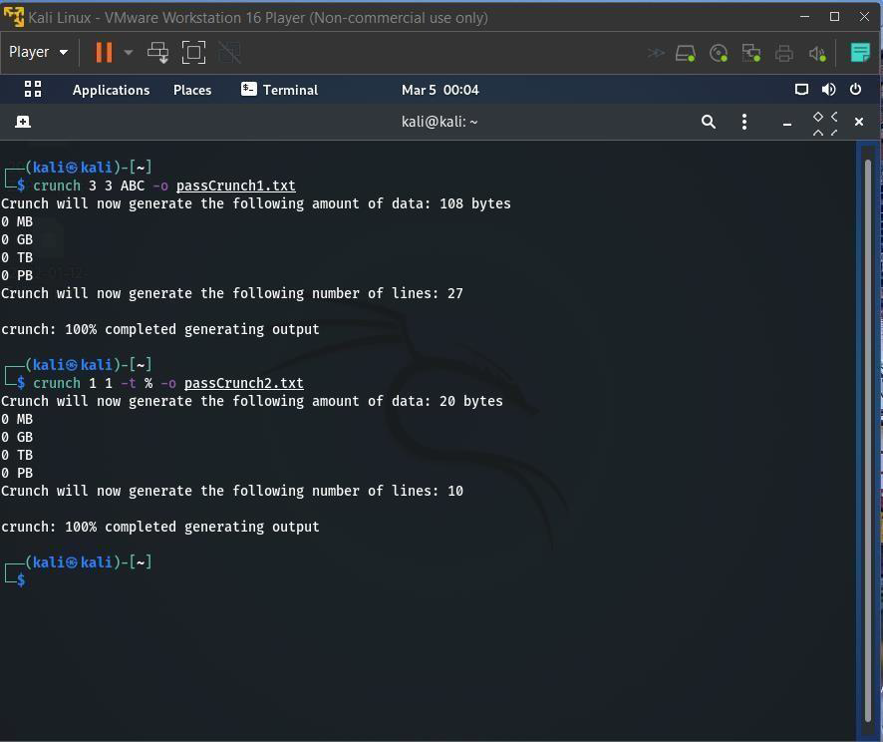

Slide 23
Exploiting Server Vulnerabilities
DOS is an attack used to deny legitimate users access to a resource such as accessing a website, network, emails, etc. or making it extremely slow. DoS is the acronym for Denial of Service. This type of attack is usually implemented by hitting the target resource such as a web server with too many requests at the same time. This results in the server failing to respond to all the requests. The effect of this can either be crashing the servers or slowing them down.

Slide 24
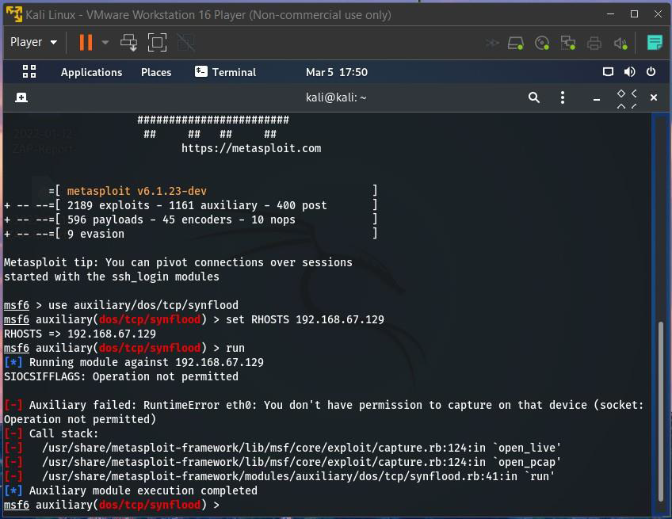

Slide 25

Result
We have learnt various fundamental concepts of Cyber Security and how to implement them.

Slide 26
Conclusion
We worked on finding vulnerabilities of System and Websites and also learnt various Cyber Security fundamentals and their implementation.

Slide 27
Thank
you!

